Slide 1

COMMUNICATION MODEL
14 JULY 2026

Slide 2
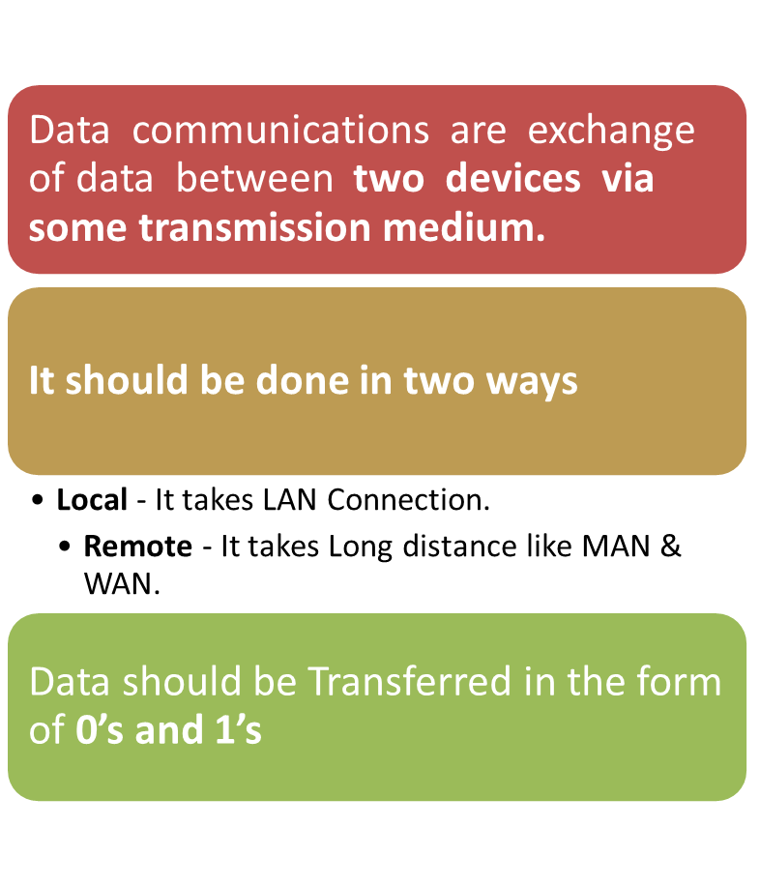
COMMUNICATION MODEL

Slide 3
BLOCK DIAGRAM FOR COMMUNICATION MODEL:
Source
Transmission Medium
Destination
CHARACTERISTICS
Delivery – the system must deliver the data to the correct destination
Accuracy – the system must deliver the data in an accurate way
Notes:
means that the information transmitted by the system must be correct, complete, and free from errors or alterations.
the data received is exactly the same as the data that was sent or collected, without any mistakes or corruption.

Slide 4
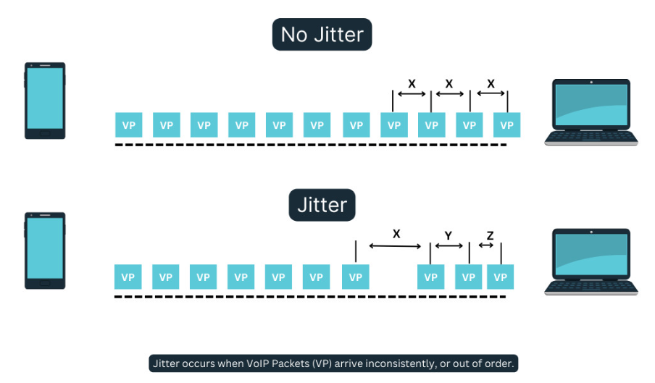
Timeline - The System must deliver the data at
Exact Time.
Jitter - It refers to the variable in the Perfect arrival time
Components of CM
Sender
Receiver
Medium
Message
Protocol
Notes:
Timeliness means the right data must reach the right destination at the right time.
Traffic light signals and sensor data must be delivered instantly to avoid accidents.
Suppose a video call sends one packet every 20 milliseconds (ms).
Ideal arrival times:
Packet 1 → 20 ms
Packet 2 → 40 ms
Packet 3 → 60 ms
Packet 4 → 80 ms

Slide 5
Sender – it is a device, that sends the information to the receiver
Receiver – a device, that receives information from the sender
Medium – physical path between sender to receiver
Message – passing informations
Protocol – set of rules and regulations that “governed” from data communication.

Slide 6
Transmission mode
It refers to the direction of information flow between two devices.
Data flow is the flow of data between 2 points
The direction of the data flow can be described as
  Simplex Mode
  Half-Duplex Mode
  Full-Duplex Mode

Slide 7
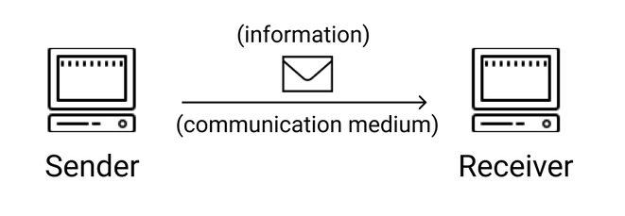
Simplex: Data flows in only one direction on the data communication line (medium).
Information is only sent by one device through the channel & not both.
Notes:
Radio broadcasting
Television broadcasting
Computer to printer
Monitor output
Mouse/keyboard/joystick to computer
Fire alarm system
loud speaker

Slide 8
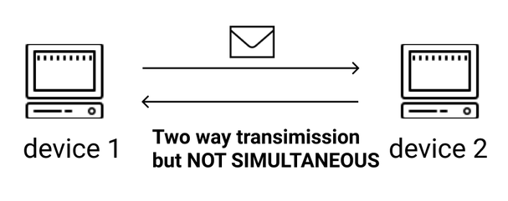
Half-duplex mode
Both communication ends can transmit data, but not at the same time
While one device is sending, the other device can only receive & vice versa
Notes:
Walkie talkie
Universal serial bus (USB)
Browsing the internet (request & responses)

Slide 9
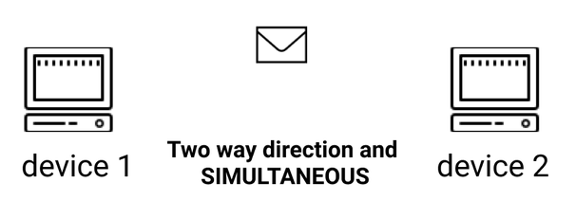
FULL DUPLEX
Allows communicating devices to transfer information simultaneously.
Unlike half-duplex, one of the devices does not wait for the other before replying
No delay in communication
Notes:
Video calls / video conferencing
Audio calls
Live chats

Slide 10
Protocol architecture
It is a layered structure of hardware, and software that supports exchange of data between systems.
It supports distributed applications (E-mail, File Transfer)
Each layer of protocol architecture provides a set of rules.
There are 2 widely used protocol architecture
  TCP/IP Architecture & OSI Model

Slide 11
protocol
Protocol is a set of rules that govern data communication
It represents what is communicated, when it is communicated and how it is communicated.
3 key elements
Syntax – data format
Semantics – control & error handling
Timing - speed matching & sequencing

Slide 12
OSI MODEL
An ISO (International standard organization) that covers all aspects of network communications is the Open System Interconnection (OSI) model.
An OSI model allows any two different systems to communicate regardless of their underlying architecture (hardware or software)
OSI model is not a protocol but a model for understanding & designing a network architecture that is flexible, robust and Interoperable
Notes:
Two software programs are interoperable if they can share data without problems.
Different hospitals can access & use a patients medical records
Different backs can transer money between each other because their systems are interoperable

Slide 13
OSI model is a layered framework for the design of network systems that allows for communication across all types of computer systems.
Built on seven ordered layers
Layer 1 – physical layer
Layer 2 – data link layer
Layer 3 – network layer
Layer 4 – transport layer
Layer 5 – session layer
Layer 6 – presentation layer
Layer 7 – application layer

Slide 14
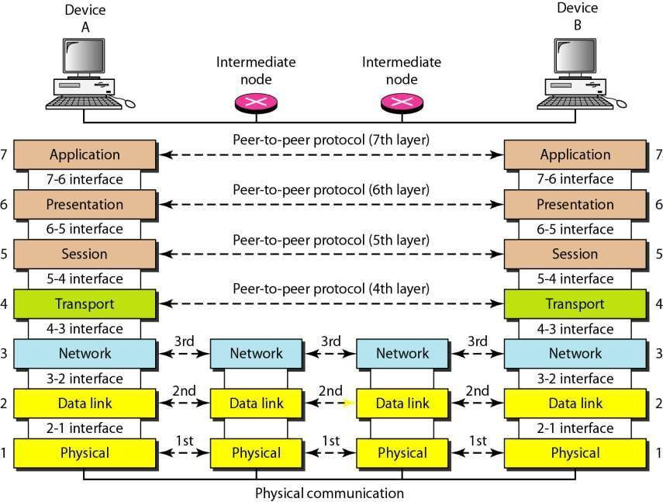

Slide 15
Peer to peer process
Within a single machine, each layer calls upon services of the layer just below it.
Layer 3, for example, uses the services provided by layer 2 and provides services for layer 4.
Between machines, layer x on one machine communicates with layer x on another machine, by using a protocol (this is a Peer-to-Peer Process)
Communication between machines is therefore a peer-to- peer process using protocols appropriate to a given layer.

Slide 16
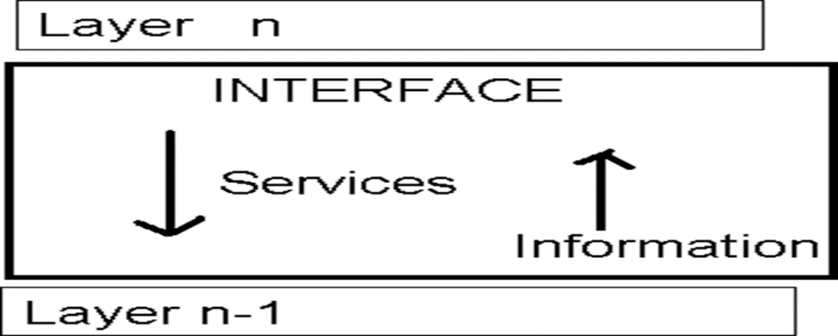
Interfaces between layers
There is an interface between each pair of adjacent layers.
This interface defines what information and services a layer must provide for the layer above it.

Slide 17
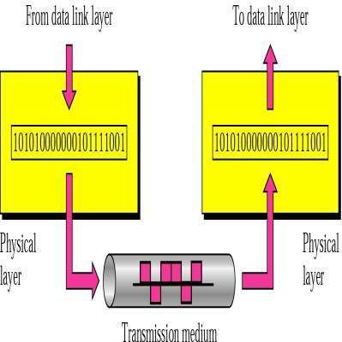
Functional of layers
Physical layer
The physical layer is responsible for transmitting individual bits from one node to the next.

Slide 18
Layer 1
Acting as the bridge for actual physical connections between devices
Its primary mission is the transmission of raw, unstructured bitstreams over a physical medium from one node to the next
It manages the hardware-level transmission of individual bits
When receiving data, it translates incoming physical signals back into digital 0s and 1s to be processed by the Data Link layer

Slide 19
Common devices operating at this level include Hubs, Repeaters, Modems, and cables.
Bit synchronization – it ensures the sender and receiver are “in sync” by providing a clock signal that controls the timing of bit transmission.
Bit rate control – it dictates the transmission speed, defined as the number of bits sent per second.
Notes:
the sender and receiver must agree on exactly when each bit starts and ends
controlling the speed at which bits are transmitted from the sender to the receiver.

Slide 20
Topologies – define the structural layout of the network, such as bus, star, or mesh configuration.
Determines the direction of data flow
  (simplex,
  half-duplex
  full duplex)

Slide 21
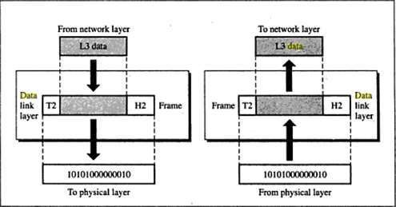
Layer 2
It is responsible for node-to-node delivery of data

Slide 22
Functions of data link layer
Framing – data packets received from network layer are divided into manageable units called frames.
Physical addressing – The DLL uses MAC addresses to identify hosts. It encapsulates the senders & receivers MAC addresses into frame header (switches & bridges),
Data link adds a header to the frame to define the physical address of the sender (source address) and/or receiver (destination address) of the frame.
If the frame is intended for a system outside the sender’s network, the receiver address is the address of the device that connects one network to the next.

Slide 23
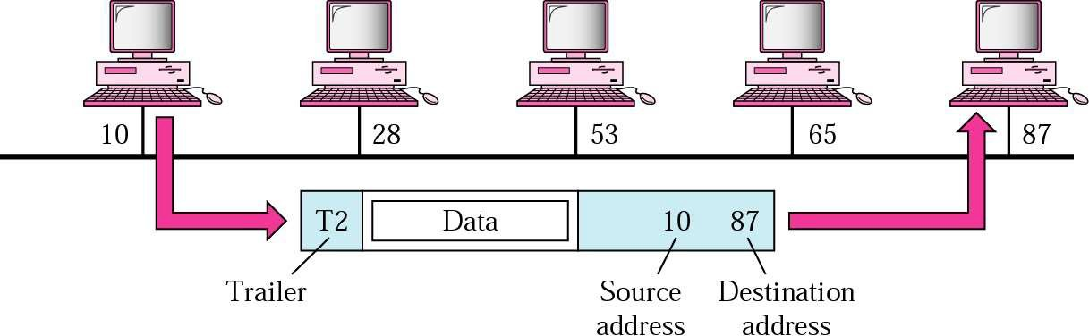

Slide 24
Flow Control. It synchronizes the data rate between a faster sender & slower receiver to prevent data “bottlenecks” or loss.
Error control. It detects & retransmits damaged or lost frames to maintain data integrity. Error control is normally achieved through a trailer at the end of the frame.
Access control – when multiple devices share CC, the MAC sublayer dictates which device has the right to transmit at any given time to avoid collisions.
Sublayers
  Logical link control (LLC) – manages flow & error control
  Media access control (MAC) – determines how devices access the transmission medium & handles addressing

Slide 25
Network layer
Is responsible for the source-to- destination
delivery of a packet across multiple networks.
It converts Frames into packets.
If two systems are connected to the same link, there is usually no need for a network layer. However, if the two systems are attached to different networks, there is often a need for the network layer to accomplish source-to-destination delivery.
Notes:
Manages data transmission between hosts across various networks by handling logical addressing & path finding

Slide 26
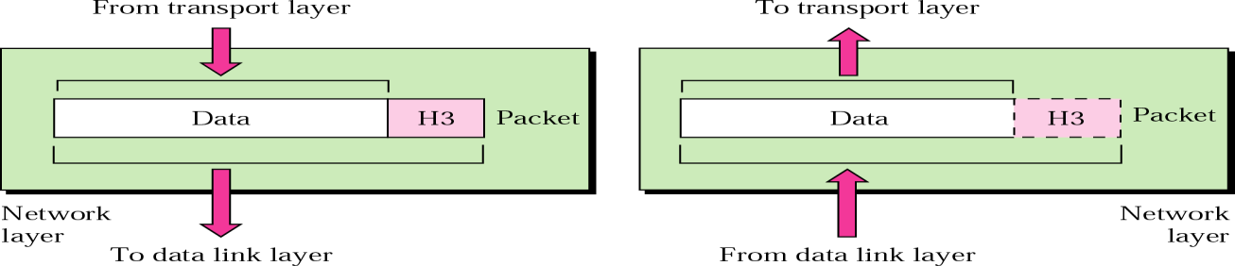
Functions:
Logical addressing - Physical addressing (May change) handle the addressing problem locally
If the packet passes the network boundary, we need another addressing
called logical addressing (Never change)
Routing - Route the packet to final destination
Notes:
Responsible for the delivery of packets from the original source to the final destination
Assigns unique IP addresses (s & R) to the packet header to identify the devices globally

Slide 27
Transport layer
The transport layer is responsible for end-to-end delivery of the entire messages.
The network layer oversees host-to-destination delivery of individual packets; it does not recognize any relationship between those packets.
The transport layer ensures that the whole message arrives intact and in order, overseeing both error control and flow control at the process-to-process level.

Slide 28
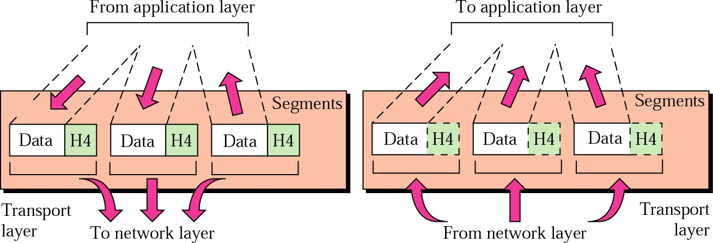
Notes:
The transport layer is responsible for delivery of a message from one process to another.

Slide 29
Functions of the transport layer
Service point addressing:
Computer often run several processes (running programs) at the same time. Process-to-process delivery means delivery from a specific process on one computer to a specific process on the other.
The transport layer header includes a type of address called a port address (port 80 for web traffic).
The network layer gets each packet to the correct computer; the transport layer gets the entire message to the correct process on that computer.

Slide 30
Segmentation & Reassembly: splits large messages into smaller segments for transmission & reassembles them in order at the destination.
Connection control: The transport layer can be either connectionless or connection-oriented.
A connectionless transport layer treats each segment as an independent packet and delivers it to the transport layer at the destination machine (UDP).
A connection-oriented transport layer makes a connection with the transport layer at the destination machine first before delivering the packets. After all the data are transferred, the connection is terminated (TCP).
Notes:
UDP – faster but offers no guarantee of delivery
TCP -

Slide 31
Functions of the transport layer
Flow control: the transport layer performs a flow control end to end. The data link layer performs flow control across a single link.
Error control: the transport layer performs error control end to end. The data link layer performs control across a single link.
Congestion control concerns controlling traffic entry into a telecommunication networks so as to avoid congestive collapse by attempting to avoid oversubscription of any of the processing or link capabilities of the intermediate nodes and networks and taking resource reducing steps, such as reducing the rate of sending packets. It should not be confused with flow control, which prevents the sender from overwhelming the receiver.

Slide 32
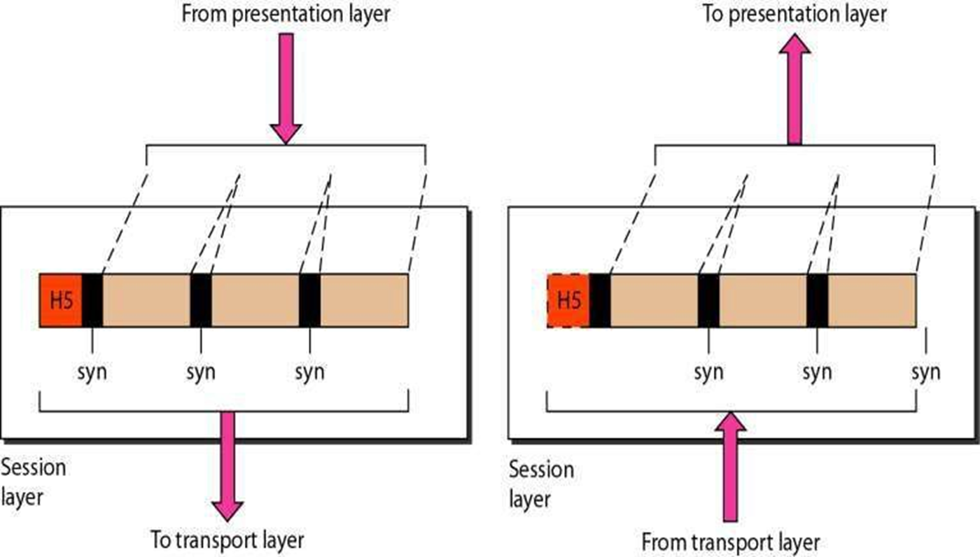
Session layer
The session layer is responsible for dialog control and synchronization.

Slide 33
Functions of session layer
Dialog Control – directs whether communication is Half Duplex, Full Duplex
Synchronization: Adding checkpoints to the data stream allows transfer to resume from the last saved point if a failure occurred.
Example: System sending 2000 pages.
Add a checkpoint after every 100th page.
So in case of failure, no need to send the whole document.

Slide 34
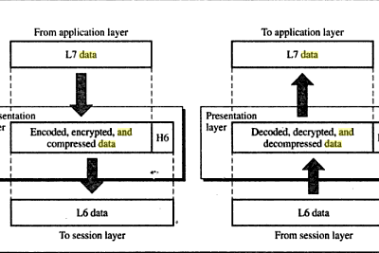
Presentation layer
It is concerned with the syntax and semantics of the information exchanged between 2 devices.
Notes:
Translation layer

Slide 35
Functions of presentation layer
Formats, secures & compresses data for transmission
Translation – extracts data from Application layer & converts it into a standardised format for network transmission.
Encryption – Converts plaintext to ciphertext (encryption) and vice versa using key values.
Compression – Reduces the number of bits required for transmission, increasing network efficiency & speed.

Slide 36
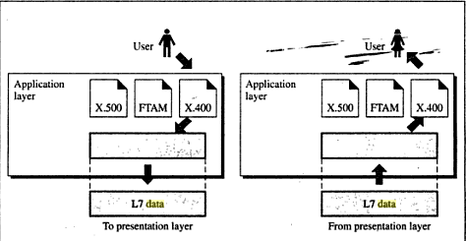
Application layer
The application layer is responsible for providing services to the user.
Notes:
- Direct interface between software user & network

Slide 37
Functions of Application layer
It provides user access to the network.
Core protocols – high level (HTTPs (web), SMTP (Email), FTP ( File Transfer ), and DNS ( domain name resolution)
FTAM – File Transfer Access & Management ( provides framework for users to retrieve, manage & manipulate) files stored on remote computers
Network Virtual Terminal enables users to log in and interact with remote hosts
Notes:
Act as a window for network-based applications ( web browers or email clients)

Slide 38
Data flows in the osi model
Application Layer - Applications create the data.
Presentation Layer - Data is formatted and encrypted.
Session Layer - Connections are established and managed.
Transport Layer - Data is broken into segments for reliable delivery.
Network Layer - Segments are packaged into packets and routed.
Data Link Layer - Packets are framed and sent to the next device.
Physical Layer - Frames are converted into bits and transmitted physically.
Notes:
Each layer adds a specific information to ensure the data reaches its destination correctly

Slide 39
Person A sends an e-mail to his friend Person B.
Step 1: Person A interacts with e-mail application like Gmail, outlook, etc. Writes his email to send. (This happens at Application Layer).
Step 2: At Presentation Layer, Mail application prepares for data transmission like encrypting data and formatting it for transmission.
Step 3: At the Session Layer, there is a connection established between the sender and receiver on the Internet.
Step 4: At Transport Layer, Email data is broken into smaller segments. It adds sequence number and error-checking information to maintain the reliability of the information.
Step 5: At Network Layer, addressing of packets is done to find the best route for transfer.
Step 6: At Data Link Layer, data packets are encapsulated into frames, then MAC address is added for local devices and then it checks for errors using error detection.
Step 7: At Physical Layer, Frames are transmitted in the form of electrical/ optical signals over a physical network medium like ethernet cable or WiFi.

Slide 40
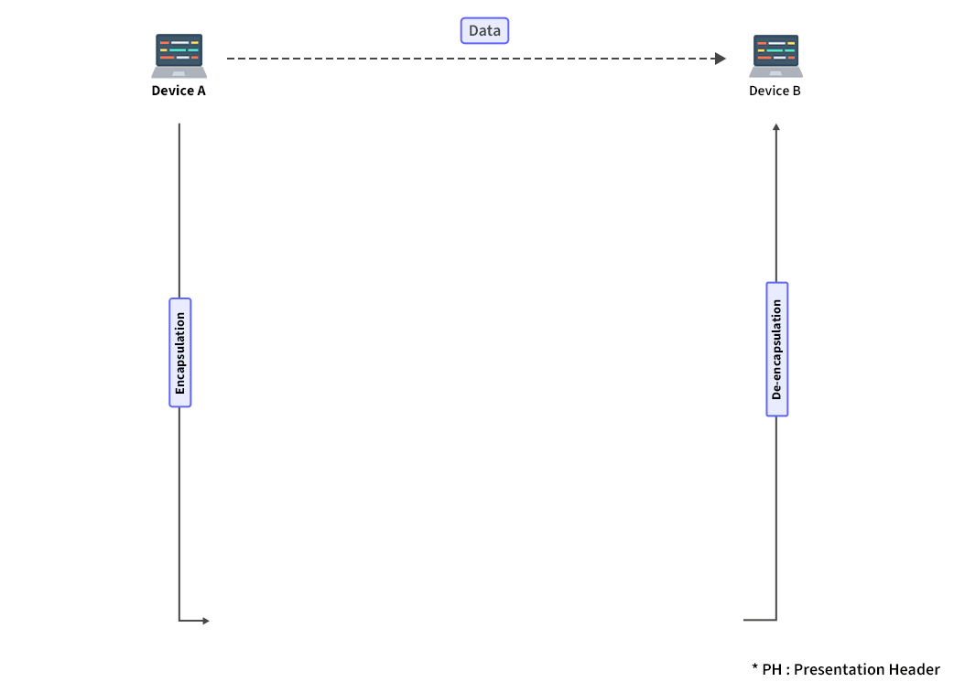

Slide 41

Friday 17 July 2026
TCP/IP PROTOCOL ARCHITECTURE

